Slide 1

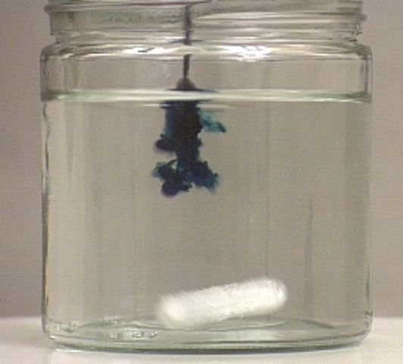
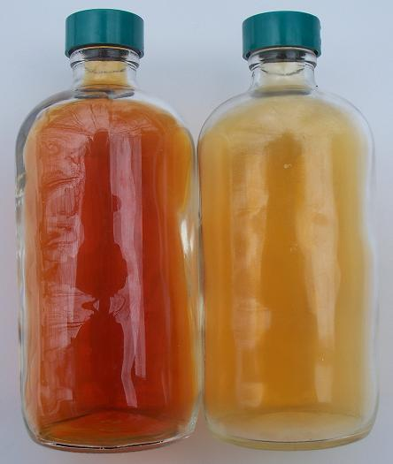
CHEM 450/450G
Dr. M. J. Nee
Lecture II-2
Mixtures, Chemical Potential, and Equilibrium
Plan for Today:
Gibbs Energy of a mixture of gases: Intro to Equilibrium
Temperature dependence of G
Fugacity
Chemical potential and phase change

Slide 2
Chemical Potential: A review
For a mixture of several components, we can write the differential for Gibbs Energy in terms of components
where we define the chemical potential for each component as the partial molar Gibbs energy:

Slide 3
Gibbs energy for any reaction mixture
For a mixture at effectively constant composition, we can treat μ as independent of n!
So that
What does this mean?

Slide 4
Mixtures of gases:
= A
= B
(1)
(2)
Condition for equilibrium
Pressure dependence of G

Slide 5
Gibbs Energy of an Ideal Gas Mixture
There is an entropy and a Gibbs energy associate with mixing of components:
To calculate the entropy of mixing, we note that

Slide 6
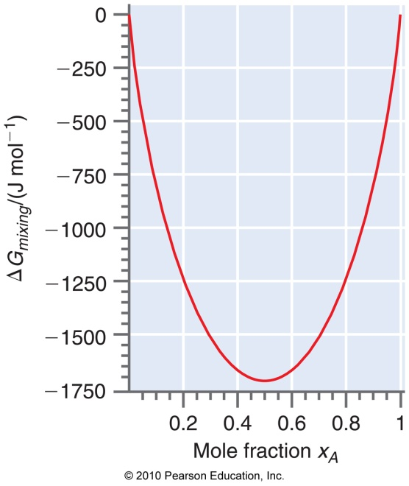
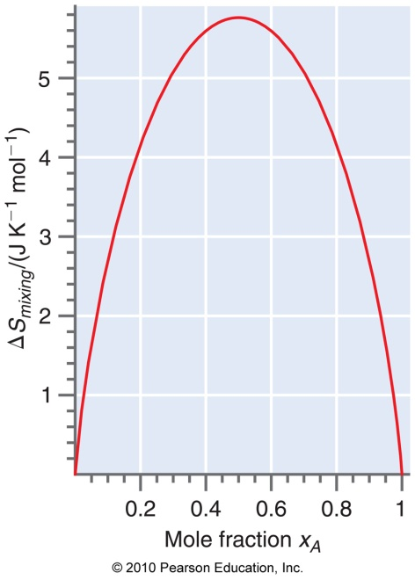
Entropy and Enthalpy of mixing
For ideal solutions

Slide 7
Gibbs energy for a reaction: general
We begin with entirely gas-phase reactions, and our discussion is entirely general: we have a reactive mixture of gases, with a total pressure
To calculate ΔG_{R}, we need the ΔG_{f} for each component:
Doing this for each component, and using

Slide 8
Reaction Quotient, Q_{P}
This is the origin of using the reaction quotient (Q_{P})and equilibrium constant (K_{P}):

Slide 9
Equilibrium Constant, K_{P}
At equilibrium, ΔG_{R} = 0. We solve our previous equation to show that, at equilibrium,
Q_{P} tells us about the ratio of products to reactants at any point during the reaction. At equilibrium, a given system will always reach the same equilibrium constant, K_{P}.

Slide 10
Le Châtelier’s Principle
A system perturbed from equilibrium will tend to adjust its concentrations in such a way as to reestablish equilibrium
Change T?
Change P_{NO2}?
Change P?
Change Volume?
But we can be more quantitative than that…

Slide 11
Temperature and Equilibrium
We use the Gibbs-Helmholtz equation to determine T-dependence of K_{P}.
Integrating both sides for the difference in T from 298K:
Or, for any two temperatures, the van’t Hoff Eqn:

Slide 12
Fugacity (f) and Fugacity Coefficient (γ)
For real gases, pressure is not directly proportional to n. We use fugacity (f), which is like an effective pressure exerted by the gas.
Where pressure and fugacity are related by the fugacity coefficient, γ, according to:

Slide 13
Calculating fugacity
So that, for a van der Waals gas above the Boyle T,

Slide 14
Extent of reaction, ξ
Le Châtelier’s principal really tells us about how the extent of the reaction (ξ) changes after a perturbation. We relate ξ to mole fraction for a simple reaction:
If we start with n moles of O₃, at any point in the reaction, we have
ξ moles of O₂
moles of O
(n - ξ) moles of O₃

Slide 15
Relating G to ξ
As a reaction progresses,
n_{i} : moles of component i
n_{i}⁰ : initial number of moles of i
υ_{i} : stoichiometric coefficient (negative for reactants, positive for products).
How is this related to mole fraction of components?
At any time during the reaction, we can say that

Slide 16
Equilibrium partial pressures: an example
Example 6.10 is pretty informative:
Starting with n₀ moles of Cl₂
What is K_{P}?
Calculate the degree of dissociation, α, as a function of pressure and K_{P}, where

Slide 17
Equilibrium constant and concentration
Text asks you to wait until Chapter 9. Meh.
We can still limit ourselves to gases, and talk about concentration or mole fraction instead.

Slide 18
Mole fraction K_{x}

Slide 19
Concentration, K_{C}
Here, the c° is there to make the units work out... it is effectively 1 M (a “standard concentration”).

Slide 20
Reading: We begin phase change and the properties of liquids next; read Chapter 8.
HW 4: You have everything you need for that HW (and some of HW 5). It is due Tuesday, 10/4.

